Slide 1
Introduction to statistical genomics
Leeds Omics
12th December 2016
Jenny Barrett
Section of Epidemiology and Biostatistics, LICAP, Medicine

Slide 2
Study design
Exploratory data analysis
Hypothesis testing
Estimation
Regression models
Clustering
Bayesian inference
Classification

Slide 3
Study design
Exploratory data analysis
Hypothesis testing
Estimation
Regression models
Clustering
Bayesian inference
Classification

Slide 4
Outline
Hypothesis testing
  Difference in two proportions
  Difference between two means
Application to –omics
  Multiple testing
  Quality control
  Examples from transcriptomics and genome-wide association studies

Slide 5
Hypothesis testing
Most medical or biological research is concerned not just with description, or exploring patterns, but with testing out theories
  e.g. that Drug A is more effective than Drug B at reducing tumour size
One of the aims of research is to formulate theories into research hypotheses, then design and conduct studies to test these
Evidence in favour of a hypothesis is usually measured by considering the evidence against the converse null hypothesis

Slide 6
Structure of a hypothesis test
State the null and alternative hypotheses
  H₀: Drug A and Drug B are equally effective at reducing tumour size
  H_{A}: there is a difference between the effectiveness of Drugs A and B
Define and evaluate a test statistic
Calculate the p-value
  This is the probability of observing a value of the test statistic at least as extreme as the value actually obtained, if H₀ is true
Interpret the results

Slide 7
Transcriptomics
Sample of 51 primary melanoma tumours and 53 metastatic melanoma tumours (from different patients)
Gene expression levels are measured for each tumour for over 11,000 gene probes
Consider one gene expression probe (Probe 117)

Slide 8
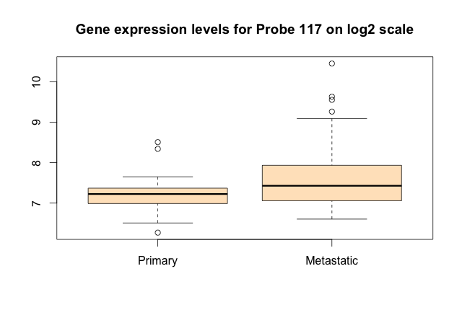
What valid inferences can we make about the population from what we observe in the sample?

Slide 9
Simple hypothesis test
H₀: Mean expression levels are the same in primary and metastatic melanomas
  H_{A}: Mean expression levels differ between primary and metastatic melanomas
A suitable test for the difference between two means is the t-test

Slide 10
Two-sample t-test
Mean in the primaries is 7.20 and mean in the metastatic tumours is 7.63
Difference in means is -0.436 with standard error 0.127
T-statistic is -0.436/0.127= -3.44
For reasonably large sample sizes the t-distribution is close to the standard Normal distribution

Slide 11
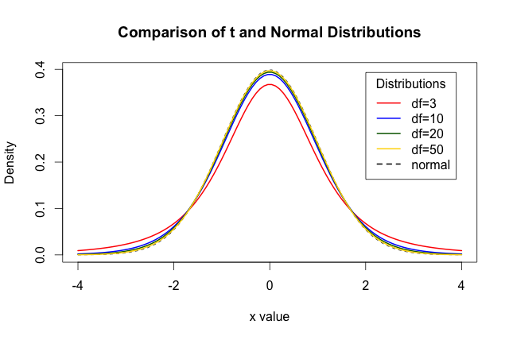

Slide 12
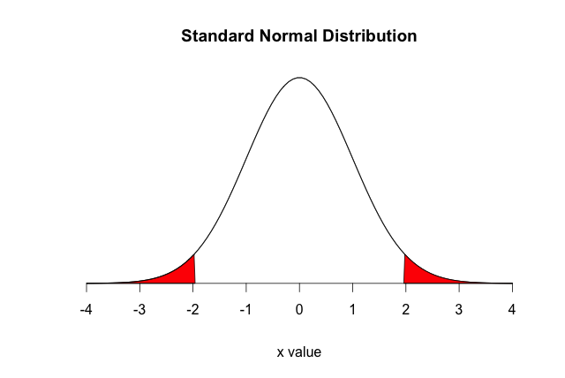
95% of values lie within the limits from -1.96 to +1.96

Slide 13
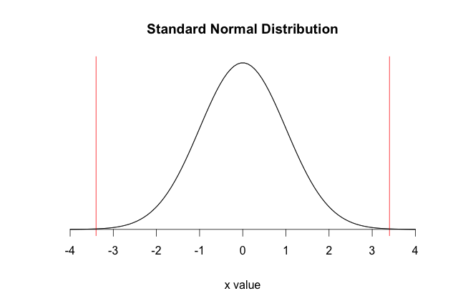
P-value is the probability of observing a statistic in the outside the red lines

Slide 14
Interpret the result
In this analysis P=0.001
Assuming our sample is representative, we are unlikely to have seen this in the sample if there is no difference in the population (i.e. we’d see such a result about one in a thousand times)
The expression levels of this gene appear to differ between primary and metastatic tumours – WE WILL RETURN TO THIS LATER!

Slide 15
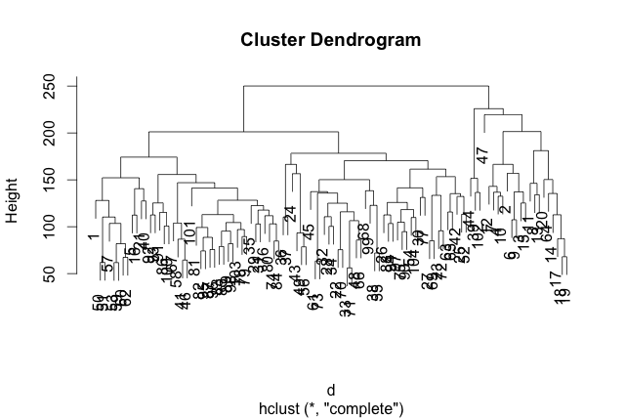
Clustering of samples based on transcriptomic data

Slide 16
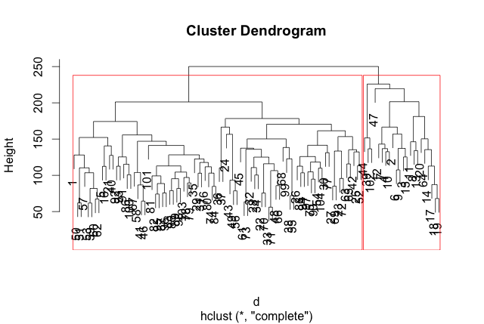
Clustering of samples based on transcriptomic data

Slide 17
Testing for a difference in two proportions
H₀: The proportion of primary tumours in each cluster is the same
H_{A}: The proportion of primary tumours differs between clusters
  We can use a chi-squared test for a difference in proportions
  Statistic is 14.0, with 1 degree of freedom
Cluster | Primary | Metastatic | Total
1 | 48 (58.5) | 34 (41.5) | 82
2 | 3 (13.6) | 19 (86.4) | 22
Total | 51 | 53 | 104

Slide 18
Chi-squared distribution (1 df)
3.84
95% of values are less than 3.84

Slide 19
Chi-squared distribution (1 df)
3.84
P-value is the probability of observing a statistic greater than 14.0,
which is 0.0002

Slide 20
Interpret the result
In this analysis P=0.0002
The two clusters based on the patterns of gene expression data contain different proportions of primary/metastatic tumours
This is very unlikely to just be due to chance, so we can conclude it applies to tumours in the population

Slide 21
Issues that arise in -omics
We often carrying out thousands or even millions of tests
It is not feasible to scrutinize each test, e.g. drawing plots and checking assumptions
Care must be taken in making inferences from the sample to the population
Key areas:
  Multiple testing correction
  Quality control

Slide 22
Hypothesis tests
True difference No difference
+ve result
-ve result

Slide 23
Hypothesis tests
True difference No difference
+ve result
-ve result
✓ | x
x | ✓

Slide 24
Type 1 and Type 2 errors
True difference No difference
+ve result
-ve result
True positive | False positive
False negative | True negative
False positive results: type 1 errors
False negative results: type 2 errors
We aim to keep the rates of both of these low

Slide 25
Significance level
True difference No difference
+ve result
-ve result
True positive | False positive
False negative | True negative
Significance level:
Probability of a positive result when there is really nothing to detect, i.e. under H₀

Slide 26
Significance levels
Significance level (α): probability of a positive result when there is really nothing to detect, i.e. under H₀
So if we always use α of 0.05, then in 5% of our experiments we’d get a positive result even if H₀ was always true
In the analysis of –omics data, a rethink is needed

Slide 27
Multiple testing correction
If tests are independent, we can easily calculate the correct α to ensure that we only get a type 1 error in 5% of experiments on average (family-wise error rate)
Bonferroni correction: divide 0.05 by the number m of independent experiments and use α/m as the significance level for each test
NB: if tests are not independent, this is conservative (more type 2 errors)

Slide 28
Many hypothesis tests
True difference No difference
+ve result
-ve result
True positive S | False positive V
False negative T | True negative U
Suppose we have m such tests
Bonferroni method, using significance level of α/m for each test, ensures that P(V > 0) ≤ α

Slide 29
Genome-wide association (GWA) studies
GWA studies aim to discover inherited genetic variants that affect disease risk
Typically we study a large number of cases and controls from the same population
The genotype distribution for each variant is compared between the cases and controls

Slide 30
Genome-wide association studies
In genome-wide studies we typically study over one million SNPs (although these may not be independent)
Genome-wide p-value is usually accepted to be 5 x 10⁻⁸ (0.05 ÷ 1,000,000), similar to a Bonferroni correction
This works well at keeping type 1 error rates low (but note that we still expect type 1 errors will occur in some studies at this level), but there will be many type 2 errors

Slide 31
Analysis of one single-nucleotide polymorphism (SNP): rs132985 in PLA2G6
Genotype | Melanoma cases | Controls
AA | 418 (33.8) | 255 (25.9)
AT | 587 (47.4) | 510 (51.8)
TT | 233 (18.8) | 220 (22.3)
Total | 1238 | 985
Usual test is a test for trend in proportions
Often carried out as a logistic regression analysis adjusting for population stratification
Estimated per-allele odds ratio 0.79, P=0.0002

Slide 32
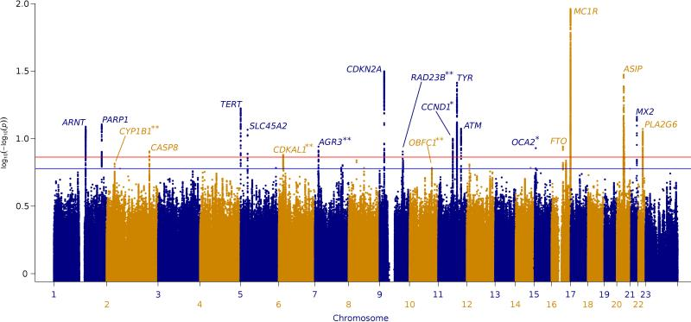
Manhattan plot from GWA study of melanoma: >12,000 cases and 23,000 controls

Slide 33
False discovery rate
Using a stringent threshold means that many true associations will fall below this (high type 2 error)
Another approach is to set the false discovery rate – to accept that in one particular –omics study there will be some false positives among the true ones, but control the expected value of this proportion
This approach is not widely adopted in GWA studies but has been widely used in studies of gene expression

Slide 34
Transcriptomic study
Gene expression levels on 11,125 probes
We are interested in which of these differ between primary and metastatic melanomas
Applying a Bonferroni correction to keep an overall α of 0.05, use α of 0.05/11,125, i.e. 4.5x10⁻⁶ for each test
354 probes show a difference at this level

Slide 36
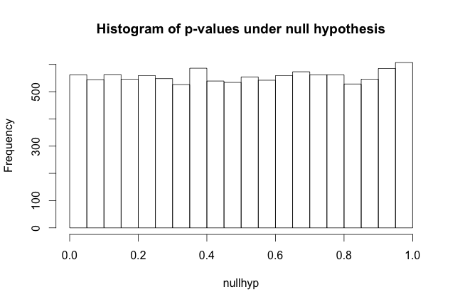

Slide 37
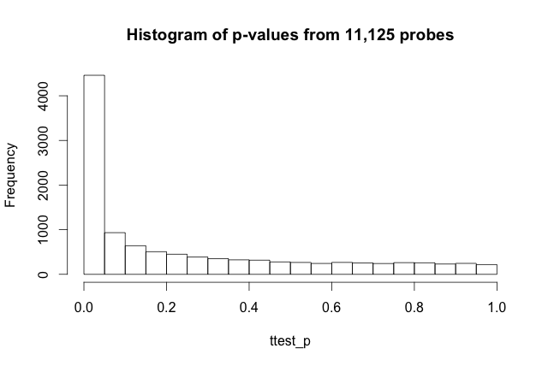
4,460 probes significant at P<0.05
556 expected by chance under H₀

Slide 38
False discovery rate
True difference No difference
+ve result
-ve result
True positive S | False positive V
False negative T | True negative U
FDR procedure is designed so that the expected value of the ratio V/(S+V) ≤ α
Benjamini and Hochberg (JRSS series B, 1995)

Slide 39
Bonferroni 0.05, 35 probes
FDR 0.05, 3288 probes

Slide 40
Quality control (QC)
With many SNPs/probes we need robust procedures to ensure the highly significant results are not due to poor QC
For SNPs, apply filters such as minor allele frequency, call rate, tests for Hardy-Weinberg equilibrium
For probes, apply filters based on minimum variance, proportion of samples where probe detected
Examine top results and outlying/suspicious results

Slide 42
Thanks for listening
Any questions?

