Slide 1


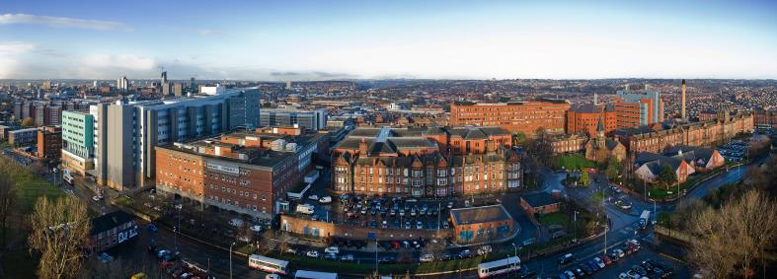
Introduction to Proteomics
Roz Banks & Alexandre Zougman
(r.banks@leeds.ac.uk) (a.zougman@leeds.ac.uk)
Clinical and Biomedical Proteomics Group

Slide 2
Clinical and Biomedical Proteomics Group
Part of the Biomarkers and Therapy Section in the Leeds Institute of Cancer and Pathology within Faculty of Medicine and Health
Relatively small multidisciplinary group (n=6 currently)
Focussed on using proteomics technologies for biomarker discovery/translation (+ mechanistic insights and novel therapeutic targets…)
Provide a local research facility for proteomics studies (www.proteomics.leeds.ac.uk)
Complements the much larger mass spectrometry facility provided in FBS (www.fbs.leeds.ac.uk/facilities/ms) – focus on protein structure and conformation

Slide 3
What is Proteomics?
Proteins represent the “functional molecules” of the cells or organism
“Proteome" – first used in 1994 by Marc Wilkins through analogy with the genome. The entire complement of proteins, including the modifications made to a particular set of proteins, produced by an organism or a cellular system.
“Proteomics“ – the large-scale study of a specific proteome. Can include many aspects such as protein abundances, modifications, sub-cellular localisation and interacting partners and networks, in order to understand cellular processes.

Slide 4
Critical Considerations/Challenges
One gene can encode more than one protein.
Human genome ~21,000 protein-encoding genes.
Added complexity - with co- and post-translational modifications, human proteins estimated 250,000 to one million.
Implications for Sample Preparation – Pre-fractionation – “Snapshots”
Proteomes are highly dynamic compared with the relatively static genome. Varies over time and in response to stimuli e.g. stress, disease etc – amounts or PTM forms of proteins.
Implications for Sample Preparation – Stability
Proteins exist in a wide range of concentrations. For example, the concentration of the protein albumin in blood is more than a billion times greater than that of interleukin-6 and 20 proteins make up >98% of the serum proteome.
Implications for Sample Preparation – Pre-fractionation (no protein equivalent of PCR)

Slide 5
Types of Proteomics
Variously named by scientific context or focus
Examples:
Clinical Proteomics - use of proteomics to address clinical questions such as biomarker discovery or pathways involved in disease
Glycoproteomics
Phosphoproteomics
Chemical Proteomics - using chemical tools to study the modification or interaction of small molecules with proteins
e.g. drug target
identification
Direct affinity resin enrichment of proteins that bind to a drug
Drug is linked to beads
Protein lysate is incubated with beads
Bound proteins identified by mass spectrometry
Bead

Slide 6
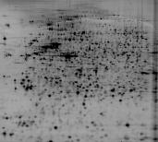
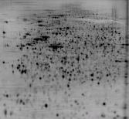
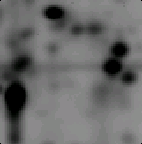
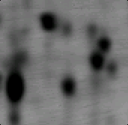
Proteomic Technologies 1
-VHL
+VHL
pI 4 7
200
200
kDa
Two-dimensional polyacrylamide
gel electrophoresis
14
Not used very often now
~2,000 proteins visualised – very good
for seeing multiple forms
But:
Very limited for hydrophobic proteins such as membrane proteins
Multiple proteins in one spot
No immediate identification – use MS
Limited dynamic range

Slide 7
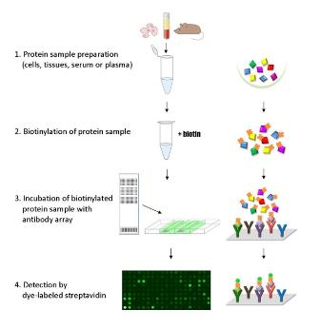
Proteomic Technologies 2
Example
Array-based techniques
e.g. antibodies, phage or reverse
phase arrays, multiplex ELISA
Targeted so determined by specific binders
Typically 50 to 2-3,000 proteins
Mass Spectrometry
Now regarded by many as the workhorse of proteomics
Main focus of the rest of this talk

Slide 8




“Typical” shotgun approach in Leeds
Study Design & Sample Selection
Tissue
Cell lines
Fractionation e.g.
immunodepletion
Label-free profiling
LC-MS/MS (DDA)
Thermo Velos
Blood
Urine
Bioinformatic &
statistical analysis
Relative quantification of
~450 serum proteins
~3-4,000 tissue proteins
~1,200 urinary proteins
F N N V S

Slide 9
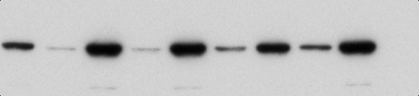



Critical Aspects of Proteomic Studies
Well defined clinical/scientific question and study population/system
Choice of technology and approach – scientific input
Appropriate study design
- avoidance of bias/confounding factors
- sample size and replicates (knowledge of technical and
biological variance), statistical input
Sample Preparation
- e.g. extraction buffer composition and additives, chemical quality
- pre-fractionation
- containers e.g. type of blood tubes, plastics etc
Data Analysis
Validation approach
- e.g. western blotting, IHC, ELISA etc
N
T
N
T
N
T
N
T
N
T

Slide 10
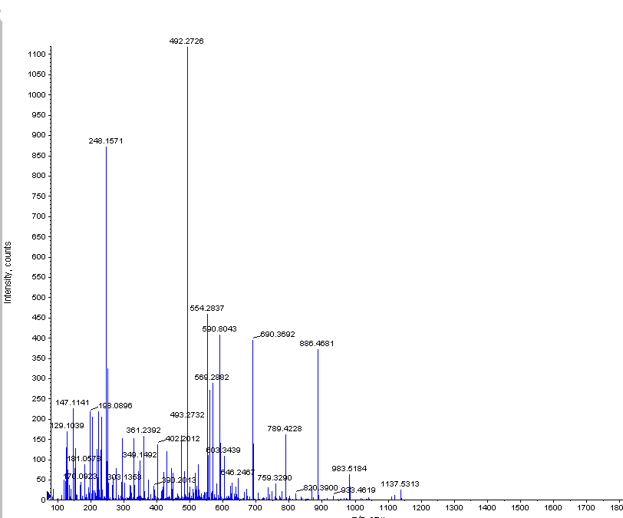
Proteomics and Mass Spectrometry
making sense out of fragments

Slide 11
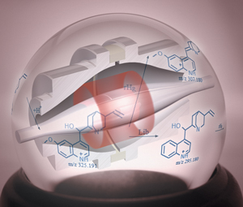

“Tout progrès scientific est un progrès de method.”
“All scientific progress is progress of a method.
René Descartes
Proteomics is an art of identification, characterization and quantitation of proteins or complete proteomes (protein pools)
Mass spectrometry (MS) is a vital tool of proteomics
During a typical proteomics experiment, the proteins are digested by proteases, the resultant peptide mixtures are separated and introduced into a mass spectrometer by a liquid chromatography (LC) system, and the distinct peptide signatures - the exact peptide mass and partial internal amino acid composition - are deduced from MS and tandem mass spectrometry (MS/MS) data
The examples illustrating the use of mass spectrometry in protein research will be presented

Slide 12
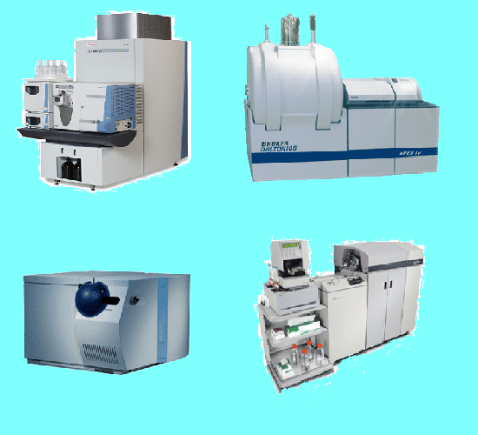

Mass spectrometers use the difference in mass-to-charge ratio (m/z) of ionized molecules for separation and detection
M/Z

Slide 13
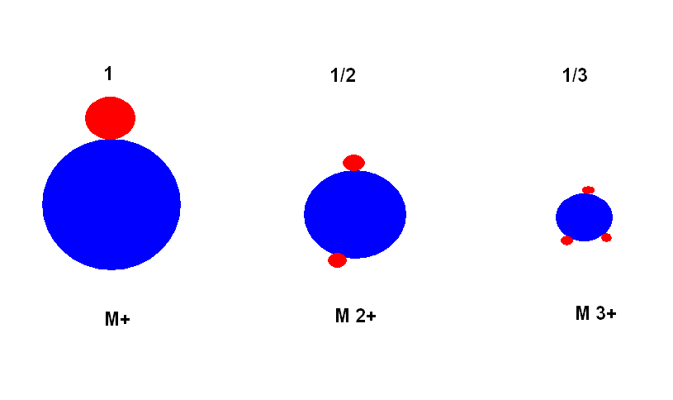
It is always Mass over Charge
H +
H +
H +
H +
H +
H +

Slide 14
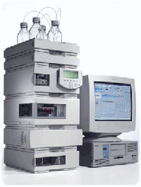
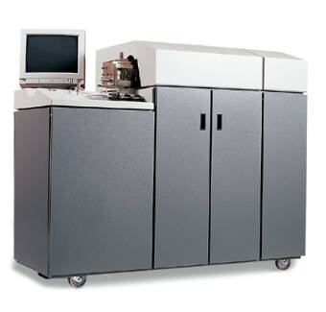
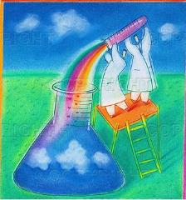
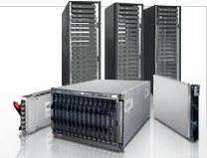
Capillary HPLC
Sample Prep
Mass Spectrometer
Data processing and presentation

Slide 15
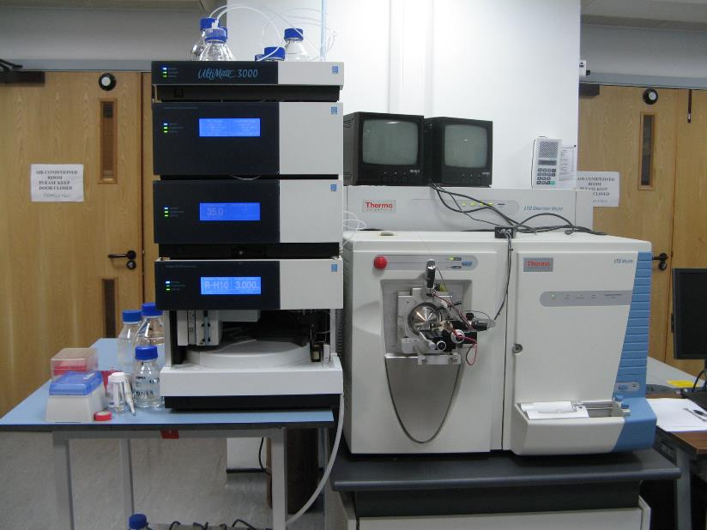
Dionex UHPLC + LTQ Orbitrap Velos Mass Spectrometer
UHPLC
High Accuracy Mass Spectrometer

Slide 16
Proteomic Approaches
Bottom-Up
Top-Down
Protein
Digestion
Peptides
Protein sequencing
Peptide sequencing
Peptide /
Protein identification
Protein identification

Slide 17
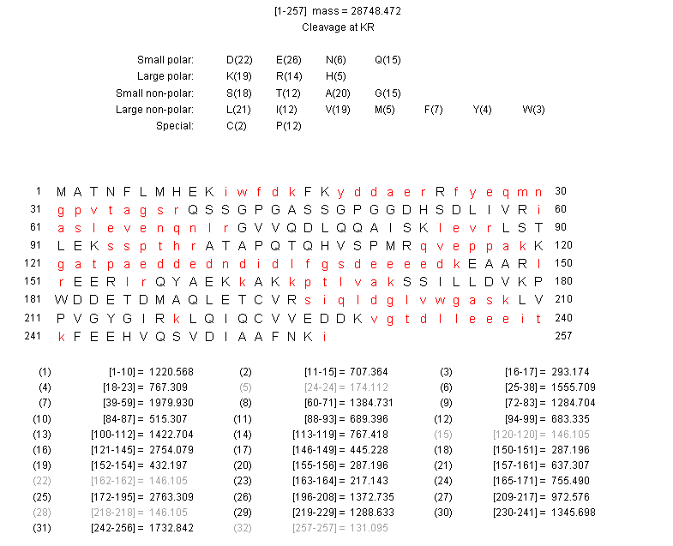
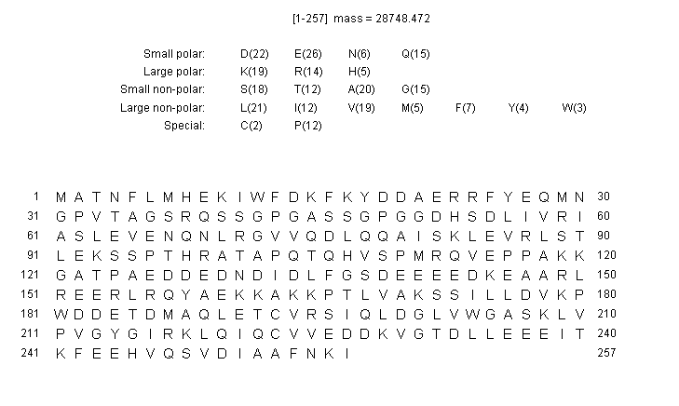
Protein digestion is a prerequisite of the MS analysis

Slide 18
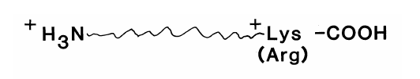
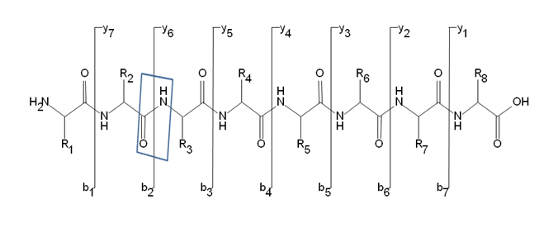
In a typical proteomics experiment a protein mixture is digested by an enzyme thus creating a mixture of peptides. The most common protease is trypsin which cuts protein C-terminally at arginine (R) or lysine (K) residues and gives rise to peptides carrying at least one basic residue. At pH 3, Asp- and Glu- are uncharged and any proteolytic peptide has the net charge of at least 2+ where one charge is located C-terminally at the basic residue and another charge is localized at the N-terminus.
The opposite location of the charges facilitates peptide fragmentation at the amide bond in the most commonly used low energy collision induced dissociation (CID) process creating y and b ion series according to Roepstorff-Fohlmann-Biemann nomenclature.

Slide 19
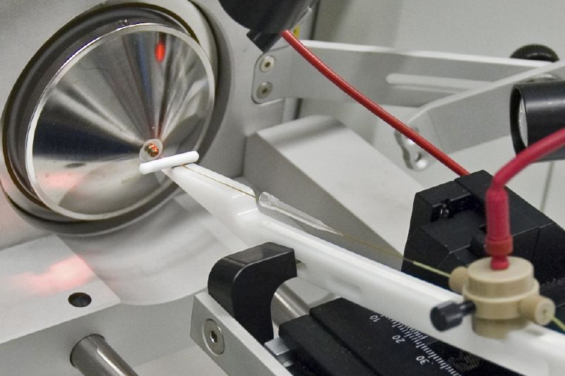
Nano-LC interface

Slide 20
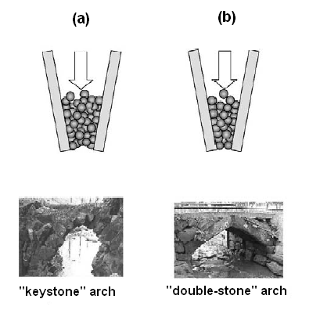
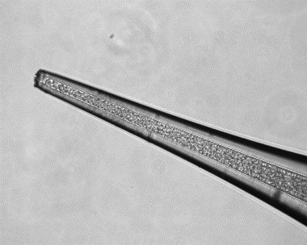
Spraying capillary column
75 µm (ID) ~ 6 µm tip
Columns utilizing arch types found in stone-bridges. (a) Tapered column with the ‘‘keystone’’ arch, (b) tapered column with the ‘‘double-stone’’ arch; (left picture) a stone-bridge with the keystone arch, (right picture) a stone-bridge with the double-stone arch (Ishihama et al. J Chromatogr A 979, 233 (Dec 6, 2002).
Fused silica spraying capillary packed
with 3µm C18 silica particles.
X400 magnification.

Slide 21

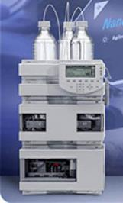
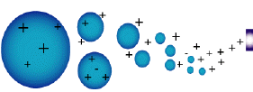

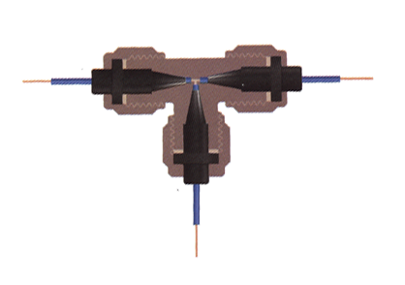
Coupling LC to MS for complex mixture analysis
Nanoflow LC/MS interface set-up
Column (75 µm)/spray tip (6 µm)
Reverse-phase C18 beads, 3 µm
No precolumn or split
15 cm
Sample Loading:500 nl/min
Gradient elution:200 nl/min
MS
Platinum-wire
2.0 kV

Slide 22
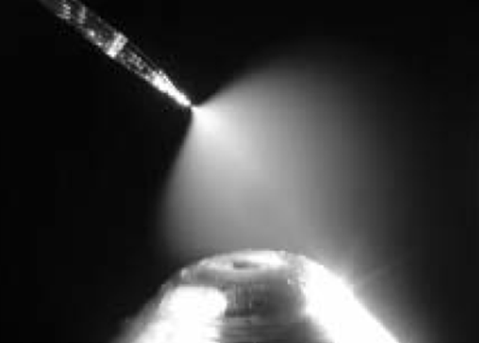
Electrospray Ionization (ESI) process introduces ionized molecules into a mass spectrometer
Taylor cone
Capillary with
analyte
Plume

Slide 23
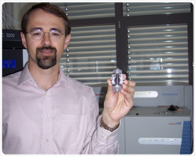
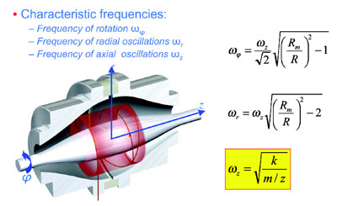
The Orbitrap Mass Spectrometer
The Orbitrap analyzer is the example of how the old concept if resurrected at the right time by an exceptional inventor could lead to creation of a truly revolutionary device. Orbital trapping was originally introduced by Kingdon in 1923.
However, the estimation of the m/z ratios was based on the frequencies of ion rotations. The approach lead to poor mass resolution because ion velocity and initial radius significantly influence the rotational frequency.
Dr. Alexander A. Makarov joined a small high-tech start-up company called HD Technologies (Manchester, UK) in the mid-1990s.
Makarov’s idea was to derive the m/z values from the frequency of harmonic ion oscillations along the field’s axis - this frequency is completely independent of energy and spatial spread of ions (patented in 1999).
The axial frequency is detected by processing the image current with Fourier Transform (FT) algorithms.

Slide 24
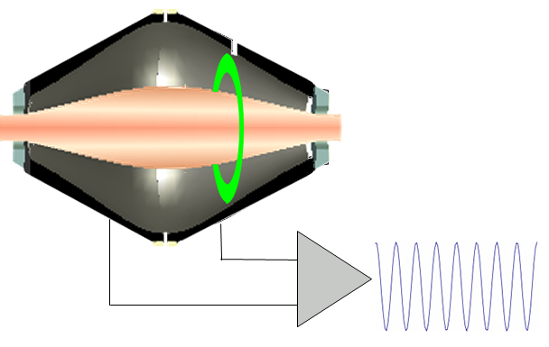
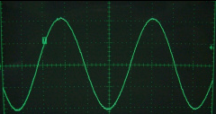
The Orbitrap
Axial oscillation

Slide 25
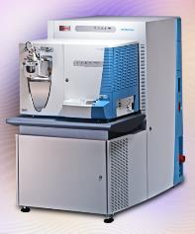

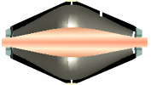


Linear Ion Trap – Orbitrap Hybrid Mass Spectrometer (LTQ-Orbitrap)
1. Ions are stored in the Linear Trap
2. …. are axially ejected
3. …. and trapped in the C-trap
4. …. they are squeezed into a small cloud and injected into the Orbitrap
5. …. where they are electrostatically trapped, while rotating around the central electrode and performing axial oscillation
The oscillating ions induce and image current into the two outer halves of the orbitrap, which can be detected using a differential amplifier
Ions of only one mass generate a sine wave signal

Slide 26
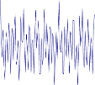
Frequencies and Masses
The axial oscillation frequency follows the formula
Where ω = oscillation frequency
k = instrumental constant
m/z = …. well, we have seen this before
Many ions in the Orbitrap generate a complex signal whose frequencies are determined using a Fourier Transformation

Slide 27
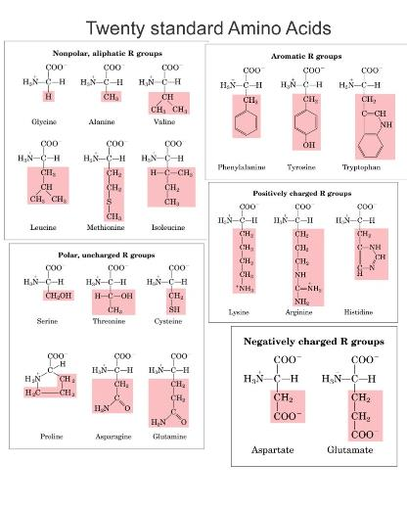
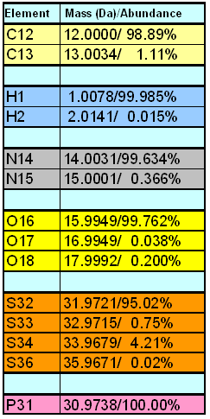
Most chemical elements exist as diverse masses in nature, the isotopes. Amino acids, the building units of proteins, contain carbon (C), hydrogen (H), nitrogen (N), oxygen (O), sulfur (S) and phosphorus (P).
About 1.11 % of the naturally occurring carbon C₁₃ atoms are 1.0034 Da heavier than the C₁₂ atoms. It means that from a random set of 100 carbon atoms about 99% will have a mass of 12.0000 Da and 1% will have a mass of 13.0034 Da.

Slide 28
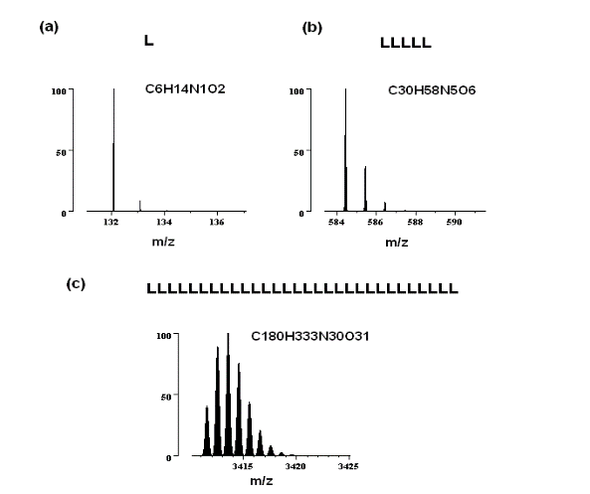
The bigger the polypeptide mass, the higher is the probability of C₁₃ incorporation into this molecule and the more prominent is the isotopic effect.
Monoisotopic peak

Slide 29
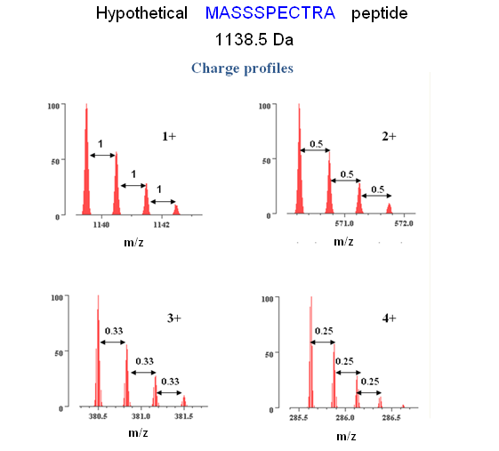
M/Z

Slide 30
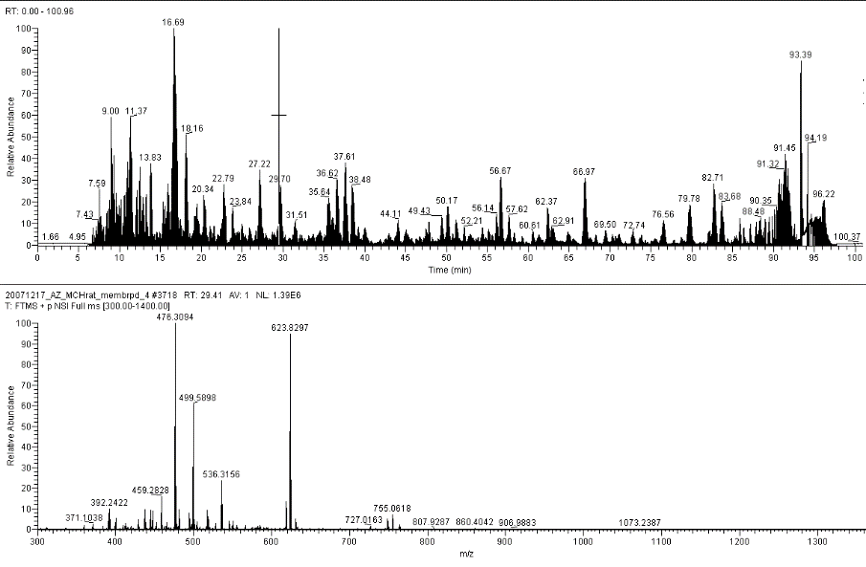
Full MS scan is performed to choose the ions for MS/MS

Slide 31
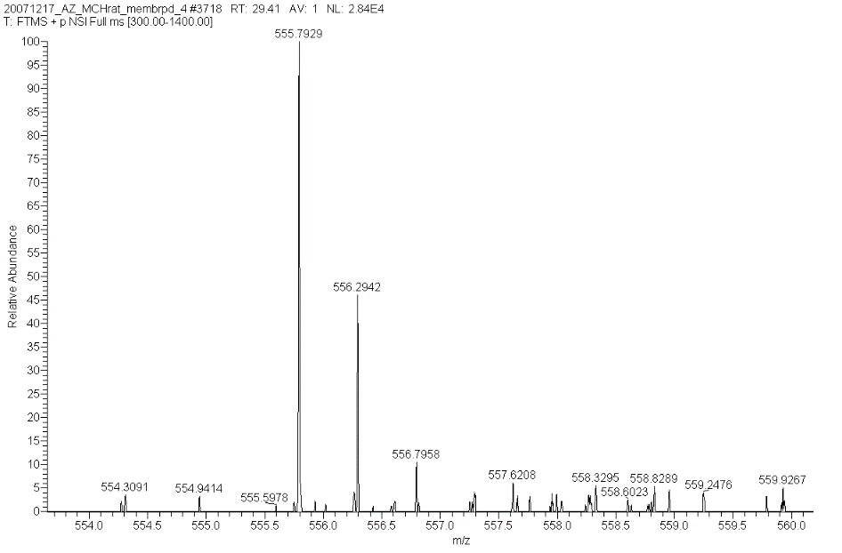
Precursor ion is chosen for fragmentation
2 +
The mass is known
0.5
0.5

Slide 32
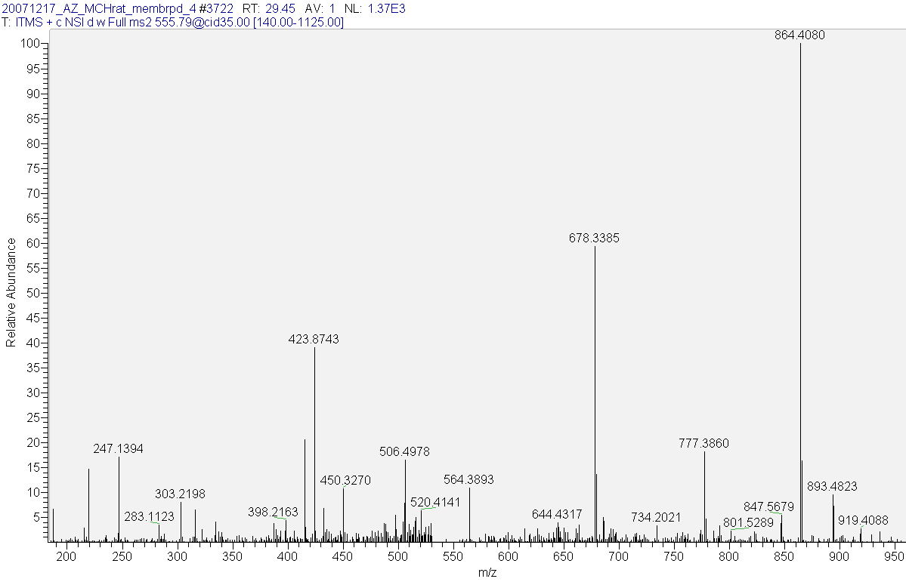
MS/MS fragmentation of the precursor 555.793 2+ ion
The fragmentation signature of the parent ion
S
V
N
N
F

Slide 33
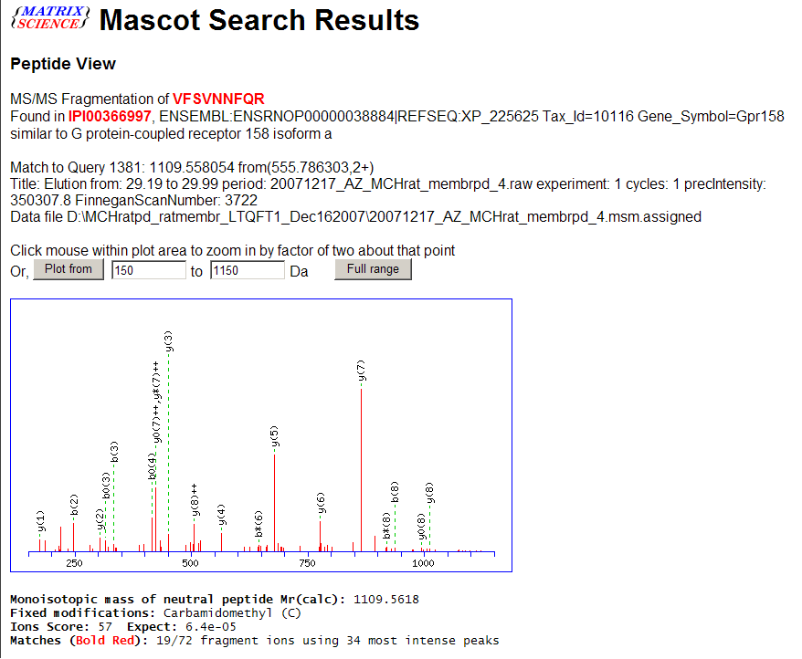
Mass of the peptide AND its fragmentation pattern = identification
VFSVNNFQR peptide of GPR 158

Slide 34
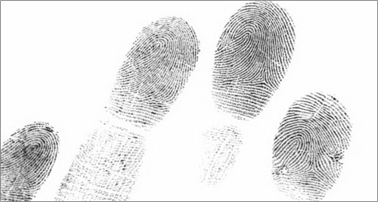
ONLY if the protein sequence is known and present in the queried database
Mass of the peptide AND its fragmentation pattern = identification

Slide 35
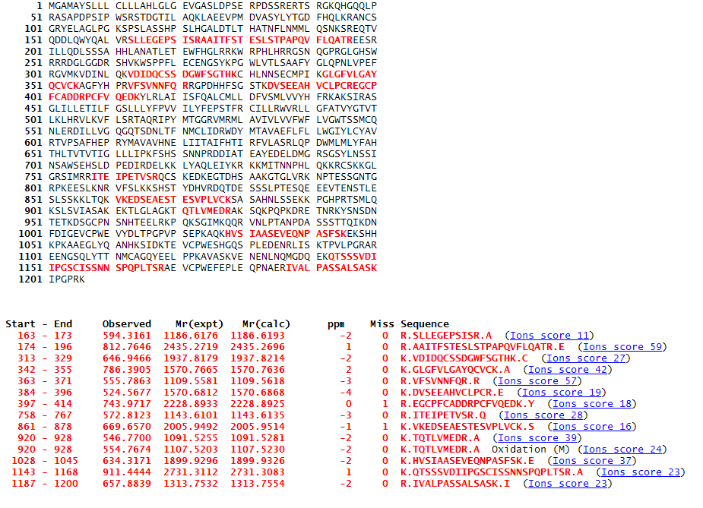
GPR158 coverage map

Slide 36
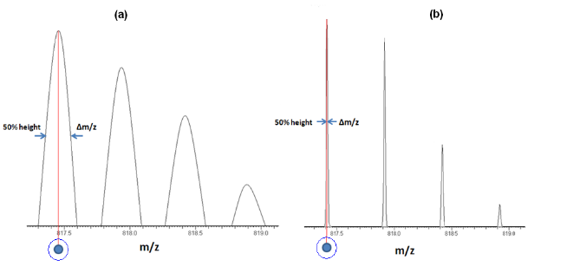
The mass accuracy of a mass spectrometer is defined as the difference between the measured mass and its calculated value. Traditionally relative mass accuracy is reported and defined in parts per million (ppm) – the mass accuracy divided by a calculated value of the measured mass.
High mass accuracy is directly related to the ability of a mass spectrometer to separate the adjacent peaks, to its resolution. The resolution could be calculated by dividing m/z of a peak by its width at a certain height (m/z divided by Δm/z). A common definition of resolution is Full Width of the peak at Half of its Maximum height, abbreviated as 'FWHM', the Δm/z value in this case is taken at 50% of the peak height .
Resolution 4000
Resolution 50000

Slide 37
High-mass accuracy – what is it good for?
Tryptic HSP-70 peptide: ELEEIVQPIISK, mass 1396.7813 Da
Instrument | LTQ | QSTAR | LTQ-FT | LTQ-Orbitrap
Mass Accuracy | 500 ppm | 20 ppm | 2 ppm | 1 ppm
# of tryptic peptides for m/z 1396.7813 | 344 | 52 | 11 | 9

Slide 38
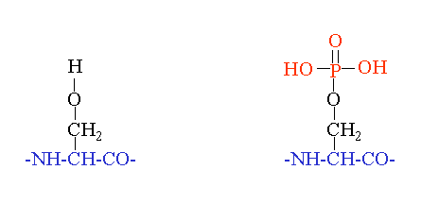
Delta mass
Most proteins are modified
The modifications could be accidental (e.g. Met oxidation), artificial (e.g. Cys derivatisation ) or natural (post-translational, e.g. phosphorylation)
When a modification is introduced, we observe a change in the mass of a peptide/protein carrying the modified amino acid – delta mass
+ 79.966 Da
serine
phosphoserine

Slide 39
High Mass Accuracy Enables Discovery of Novel Modifications
Well-known PTM: Dimethylation
Nominal mass:
28 Da
H₃C
CH₃
N
H₂C
(CH₂)₃
H
CH
O C
n=24 n=27
N
C
NH
H
H₂C
O
Mass difference = 0.03638 Da
Nε-dimethyl
lysine
(CH₂)₃
CH
Formylation
N
C
H
O
Nε-formyl
lysine
Wiśniewski JR, Zougman A, Mann M. N-epsilon-formylation of lysine is a widespread post-translational modification
of nuclear proteins occurring at residues involved in regulation of chromatin function. Nucleic Acids Res. 2008
Feb;36(2):570-7.

Slide 40
Quantitation methods in proteomics
Gel based 2D PAGE (DIGE)
Mass spectrometer
based
Label-free
Labeling with stable isotopes
¹³C, ¹⁵N, ²H
In vivo metabolic labeling (SILAC)
Chemical labeling
Affinity tags
ICAT, HysTag
Isobaric tags
iTRAQ
MS¹
MS²

Slide 41
Stable isotope labeling with amino acids in cell culture
(SILAC)
SILAC relies on metabolic incorporation of a given 'light' or 'heavy' form of the amino acid into the proteins.
Light Heavy
Upregulated
protein - Peptide ratio >1
Advantage:
High dynamic range
Coverage of entire proteomes (soluble and membrane proteins)
Weakness:
Not applicable to the real-life samples (e.g. clinical material)
Expensive
Background protein - Peptide ratio 1:1

Slide 42
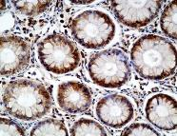
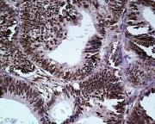
Label-free proteome quantitation
Upregulated
protein - Peptide ratio >1
Background protein - Peptide ratio 1:1
State A
State B
Run A
Protein extraction
Proteins Identification and Quantitation by LC-MS
Protein Identification and Quantitation by LC-MS
Run B

Slide 43
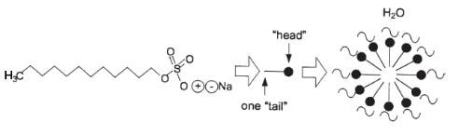

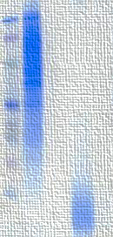


Removal of detergents is the key...
Sodium Dodecyl Sulfate
SDS
Detergents are the reagents of choice for solubilization
of proteins
Due to their ready ionization ability and high abundance detergents are incompatible with ESI MS analysis of peptides
Suspension trapping (STrap) sample preparation method for bottom-up proteomics analysis
Removal of detergents is a prerequisite for successful LC-MS profiling of peptide mixtures
Proteomics. 2014 May;14(9):1006-0. Zougman A, Selby PJ, Banks RE

Slide 44

Basic STrap method
The basic STrap method links SDS-based protein extraction with rapid detergent removal, reactor-type protein digestion and peptide clean-up
It is a simple method which does not require
sophisticated instrumentation and is aimed at high-throughput comprehensive sample processing
Detergent depletion and protein digest is done in a pipette tip
Up to 50 µg of protein could be efficiently processed in the STrap tip
Depletion of SDS and introduction of a protease
takes ca. 5 min
SDS-solubilized proteins are acidified and introduced into the STrap-tip with the quartz depth filter and C18 compartments, filled with the methanolic solution. The fine protein suspension is trapped in the depth filter. SDS and other contaminants are removed in the flow-through, and a protease is introduced. Following the digestion, the peptides are cleaned-up in the tip’s C18 part.
STrap is compatible with even elevated SDS concentrations (up to ca. 15%)
The digest is performed in 10-15 µl buffer solution. Tryptic digest is complete in 60 min at 47°C
The clean-up of the peptides takes ca. 5 min

Slide 45



STrap and cell lysates
Flow-through
HeLa lysate
Leftover
MW, kDa
Digest
HeLa lysate
MW, kDa
15 min
30 min
3 min
6 min
200
200
116
116
66
66
Annotated (%)
31
31
22
22
14
14
7
cytoplasm
nucleus
membrane
7
Our dataset
3500
2530
2295
Proteins identified
2802
Dataset of Nagaraj et al., 2011

Slide 46
Some Examples from Proteomics Studies Using Mass Spectrometry

Slide 47





T
N
4 Normal/Tumour Frozen Tissue Pairs
Sample
prep
MaxQuant label-free analysis
LC-MS/MS VELOS runs

Slide 48



CD11C
SLC5A1
SLC7A8
CD11B
CD41
5355 proteins
Claudin-1
EPHB4
CD276
RAI3
Cumulative label free intensity ratios for the identified normal and malignant colon proteins. The names of plasma membrane proteins with the intensity ratios exceeding 3xIQR confirmed in at least three pairs are displayed.
886 proteins
0
1.07
8.25
100
0.53
2.46
Total Intensity Ratio Tumor/Normal
1
2
3
4
N T
N T
N T
N T
Intracellular
Western Blot analysis of RAI3 expression in matched normal (N)/tumor (T) colon tissue pairs. Mirroring the LC-MS/MS quantitation data, the blot confirms RAI3 overexpression in all four cancer samples. Lamin A/C is used as a reference.
RAI3
Lamin A/C
Identification and confirmation of RAI3 overexpression in malignant versus normal tissue lysates.

Slide 49




A
B
C
D
Examples of RAI3 luminal and intracytoplasmic vesicular/granular staining in colon cancer and in normal colon epithelium. (A) Luminal staining in colon cancer (arrowed); (B) Intra-cytoplasmic vesicles/granules in colon cancer (arrowed); (C) Negative staining, normal epithelium with weak stromal signal. Note the neuroendocrine cells (arrowed); (D) High power view of neuroendocrine cells staining in normal colonic crypts.

Slide 50




A
B
C
D
Example staining intensities of RAI3 in colon cancer. (A) Negative; (B) Weak epithelial signal intensity with strong stromal signal; (C) Moderate intensity; (D) Strong intensity.

Slide 51

Kaplan–Meier plot of recurrence-free survival for stage I-III colon cancer patients based on dichotomized cytoplasmic RAI3 expression in tumor epithelium. RAI3 epithelial cytoplasmic expression is dichotomized as negative, weak and moderate versus strong.

Slide 52

Renal Transplantation
Biomarkers for Earlier Detection of Delayed Graft Function and Outcome
5 DGF patients & 5 non-DGF
(20 serum samples: Pre- and d2 post-transplant)
Matched for clinical variables
Immunodepleted of 14 most abundant proteins
LC-MS/MS (VELOS)
(label-free
quantitation)
Aminoacylase-1 (ACY-1)

Slide 53

ELISA Developed
Day 1 Serum ACY-1
measured
Cohort 1 (n=47)
b.
b.
Cohort 2 (n=194)

Slide 54
Prognostic value of serum ACY-1 d1 or 3
post-transplant in DGF patients
(n=52)
Welberry Smith et al. Kidney Int. 84:1214-25 (2013)

Slide 55


